Slide 1
The Real-World Data (RWD) Pipeline
Hamad Gul

Slide 2
Index
01
03
05
02
04
06
Project Overview
Execution
Reflection
Conception
Outcomes
Q&A

Slide 3


Some context
Unfamiliar domain, no prior biotech or RWD experience
New to market, highly ambiguous & greenfield product
0 - 1, product doesn’t exist!

Slide 4
01
Project Overview (The What)

Slide 5

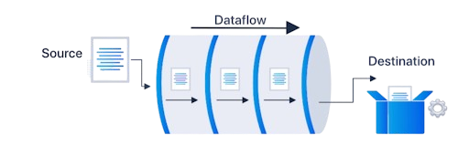
What’s the product vision?
Streamline the data transformation process, enabling seamless analysis, and accelerating research in early cancer detection.
Empower researchers to derive insights more efficiently, helping improve patient outcomes by facilitating quicker, data-driven decisions in the battle against cancer.
To create a scalable, high-throughput, configurable, and robust automated data pipeline that normalizes clinical Real-World Data from diverse sources & formats into one unified common data model (CDM).

Slide 6
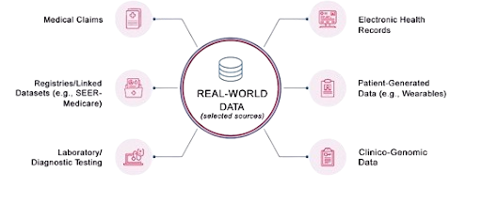

Real-World Data (RWD)
What is it?
Not to be confused with Fake-World Data
RWD is information gathered from everyday healthcare settings, such as:
Doctor visits (Symptom reports, Side Effects..)
Hospital records (Medical History, Medication Records..)
Wearable devices (Activity levels, Heart Rate..)
Claims & Billing Data (Follow-ups, Visits, Procedure Codes..)
Don’t worry, these are all patient anonymous, meaning we are only looking at specific data points.
➢ Unlike clinical trials, RWD captures how treatments work in real-life scenarios, helping researchers and companies enhance healthcare products and improve patient outcomes.

Slide 7









Too many data formats, Too many fruit. Everytime.
RWD source
Data we receive
RWD is:
Diverse & Inconsistent
Highly Complex
Significantly Variable
Hospital Records
Bills & Claims
Wearables
I have a great recipe but I need lemons..
Other Sources

Slide 8



Goal: One unified common data model, One fruit. Everytime.
RWD source
Data we receive
Data users want to receive
Hospital Records
When life gives you lemons
Bills & Claims
Just what I needed!
Wearables

Slide 9

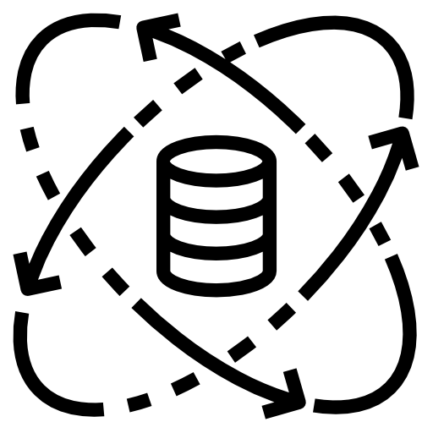


End-Users
Who benefits?
Internal Research Teams
Internal ML Teams
External Providers
➢ To conduct analysis on standardized datasets to generate medical hypotheses for early cancer detection.
➢ Streamlining ML model training without the need to constantly rewrite models for every single raw dataset.
➢ Pharma companies use RWD to understand long term effectiveness & safety of their medications.

Slide 10
02
Conception (The Why)

Slide 11

Why work on this now?
Leadership's Strategic Vision:
Leverage data from alternative clinical sources to enrich the database for ML model development.
Improving Cancer Prediction Product:
Freenome aimed to enhance the accuracy of their flagship cancer detection product by incorporating Real-World Data (RWD). More data = more precise results.
Stakeholder Feedback & Market Research:
Competitors avoided integrating RWD due to its complexities & ambiguity, giving Freenome an advantage.
Strong internal feedback emphasized the need for streamlined data normalization processes.

Slide 12

RWD Statistics
Of companies who hold RWD
44%
40%
Struggle with accessing robust RWD
Struggle with accessing critical patient RWD
54%
Of respondents plan to expand their use of health insurance claims and billing data.
Source: The Inteliquet 2019 Real-World Data Survey

Slide 13
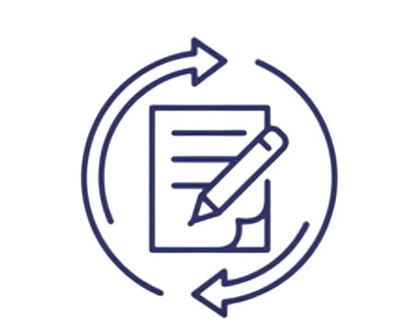
Why do we need this?
The key gap was the inconsistency in clinical RWD from different disparate sources, which impeded effective machine learning training and data analysis.
Process before RWD Pipeline:
RWD Analysts:
Having to write sophisticated queries to get data into CDM & rewrite ETL queries for new each dataset.
This was a highly manual and time consuming process..
ML Scientists:
Wait for informaticists to complete manual ETL, not much they could do without any data to train.
Data always had issues and they’d report back to RWD analysts to fix bugs.
External Partners:
Not having the resources to standardize the data, being left with twiddling thumbs & highly manual analysis.
This process negatively impacted the company's core mission due to significant turnaround times and delays in analysis.

Slide 14

…Why do we need this?
Since RWD Analysts were responsible for the highly manual ETL process of standardizing RWD, several concerns arose, including:
Management of sensitive data
Lack of documentation for standardization procedures
Limited scalability and throughput
Excessive time spent on ETL processes instead of actual data analysis for cancer detection
No version control, resulting in the need for bi-directional adjustments and manual corrections between normalization steps
➢ These issues led to frustration among RWD Analysts, introduced data bugs with no traceability, and caused delays in delivering data to ML teams & data analysis themselves, directly hindering the company's core mission of detecting cancer at its earliest stages.

Slide 15
03
Execution (The How)

Slide 16

Teams & Roles
RWD Informatics
Infrastructure Eng
Data Governance
➢ SME’s on RWD & pipeline users. Main set of requirements came from them. Team of analysts.
➢ Eng team responsible for allocating cloud resources and permissions for RWD Pipeline.
➢ Since data was sensitive Data Governance needs to approve of any processes involving sensitive data.
RWD Engineering
TPM
Customer Success
➢ Drive the team to deliver impactful, high-quality work with a strong emphasis on optimizing the user experience.
➢ Team responsible for developing the RWD Pipeline.
➢ Communicated requirements to/from external data partners.

Slide 17


Let's plan it!
Strategic Alignment:
Engage stakeholders to ensure the envisioned product aligns with the company mission & gather high-level requirements.
Define success metrics and KPIs to measure value before development.
Technical Viability Assessment:
Collaborated with engineering team lead to evaluate feasibility based on high-level requirements.
OKRs & Progress Tracking:
Drafted OKRs to monitor product progress, tied to company goals & objectives.
Worked with engineering teams, product managers, and senior leadership to ensure alignment and transparency.
Notes:
Now, let’s talk about how I planned this project.
First, we focused on strategic alignment. We engaged with key stakeholders to ensure that the envisioned product aligned with Freenome’s core mission. At this stage, we also gathered high-level requirements and made sure we had a clear understanding of the success metrics and KPIs we would use to measure the product’s value even before development began.
Next was the technical viability assessment. I collaborated with engineering team leads to evaluate the feasibility of the project based on these high-level requirements. We needed to ensure that what we were proposing was technically achievable within our timelines and resources.
From there, we moved on to OKRs and progress tracking. I drafted OKRs (Objectives and Key Results) that were directly tied to company goals and objectives. This helped us monitor product progress effectively and ensured we had clear milestones along the way. Throughout this process, I worked closely with engineering teams, product managers, and senior leadership to maintain alignment and transparency across all levels of the organization.
This planning process set a strong foundation for the project, allowing us to move forward with confidence.

Slide 18


Let’s define it!
Initial interviews with Stakeholders & Users:
Collected insights on necessary outputs, integration points, and pain points.
Ideated solutions based on user pain points, gathered insights, and collaborated with stakeholders to refine and iterate on those solutions.
Biweekly Team Meetings:
Regular sync between engineering, RWD Analysts (SMEs), and myself.
Discussed ongoing requirements, showcased demos, and aligned teams.
1-on-1 Stakeholder Meetings:
Regular discussions with critical stakeholders:
Engineering Managers
Director of RWD Informatics
Upstream/Downstream Product Managers

Slide 19
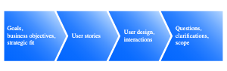
...Let’s define it!
MVP Feature Prioritization:
Used frameworks like MoSCoW and RICE to identify critical features for the MVP.
Confirmed prioritization with engineering and stakeholders, adjusting as needed.
Documentation into PRD:
Maintained a Product Requirements Document (PRD) to track:
Requirements
Deadlines & Timelines
Major decisions
Ensured visibility and alignment across all teams.

Slide 20



Challenges during definition & planning
Navigating complex integrations requirements
Complex I/O integration requirements for pipeline were tricky. Required plenty of cross team collaboration & investigation.
Stakeholder Alignment
Conflict between stakeholders regarding feature prioritization. I used prioritization frameworks to back decisions using data, working on features that are business & goal critical first aligning stakeholders.
Navigating conflicting implementation ideas
Disagreements on technical implementation details between end-users & engineering team. eg Informatics group wants to use library X in python while Engineering wants to use library Z. We A/B tested both, discussed as a team and aligned!

Slide 21

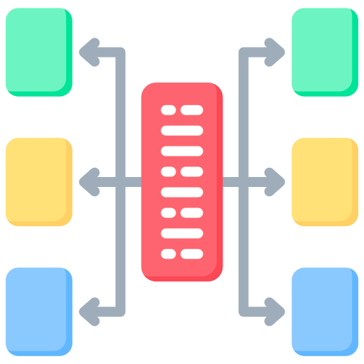
Let's develop it!
Breaking Down Major Features:
Divide key features into EPICs in JIRA (e.g., Data Ingestion, Syntactic & Semantic Normalization, Structural & Post Processing), breaking down features into manageable pieces.
Story Mapping & Sprint Planning:
Conducted story mapping sessions (or PI Planning) every quarter to brainstorm user stories for epics, ensuring alignment with OKRs & business objectives.
Converted stories into JIRA, wrote user stories with UAT and estimated with engineering, and pre-planned sprints for operational efficiency. Made sure to prioritize stories in alignment with product roadmap.
Documentation & Diagrams:
Create data flow diagrams, feature documentation, RAID logs, and API documentation to support development.
Document any bugs and proactively write them in JIRA.

Slide 22
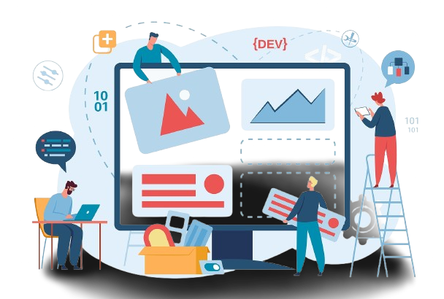
…Let's develop it!
Working Agile:
Lead all agile ceremonies for the RWD Team, including:
Daily standups
Backlog grooming
Sprint planning
Retrospectives
Tech Stack & Architecture Collaboration:
Work with the Tech Lead to define the high-level tech stack and architecture.
Collaborate with other teams to identify similar use cases and prevent duplicated efforts.
Initiated development with SPIKEs, allowing engineers to draft detailed system designs and architecture at a lower level.

Slide 23



Challenges during development
Technical Debt
Accumulated technical debt slowed feature development. We addressed this by refactoring code and improving documentation to streamline future updates, I’d make sure to include tickets every quarter to assess & resolve tech debt proactively.
Resource Allocation
Limited resources caused milestone delays. We optimized team roles and responsibilities to ensure efficient use of available resources. I created a RACI matrix to define roles explicitly.
Blockers & dependencies
Processes involving sensitive data required approvals from privacy and IP teams, while cloud infrastructure processes needed Infra tickets. I developed streamlined workflows to proactively manage dependencies and remove blockers.

Slide 24

Let’s test it!
User Acceptance Testing Collaboration:
Worked with RWD Informaticists on UAT, ensuring they were equipped to run the pipeline and receive & access expected results.
Provided product demos, training & manuals for seamless onboarding.
MVP Rollout:
Launched MVP to select RWD Informatics users, testing with synthetic data and then with Cerner's real-world data.
Feedback & Iteration:
Collected feedback, iterated on the product, and prepared for V1 release.
Final Preparations:
Resolved technical debt and conducted thorough pre-launch testing (load, integration, beta).

Slide 25

Let’s assess & iterate
User Feedback Collection:
Continuously gathered feedback on issues, feature requests, and user satisfaction.
Performance Monitoring:
Used analytical tools like GCP Cloud Log, BigQuery, and DataHub to track product performance and ensure alignment with KPIs.
Iterative Product Improvement:
Enhanced the product based on feedback, bug reports, performance data, and feature requests.
Regular Updates:
Delivered new features, patches, and performance improvements on an ongoing basis.
Continuous Innovation:
Conducted market research and explored new technologies to refine and advance the product.
Introduced NLP extraction from patient reports, metadata solution & ML powered anomaly detection.

Slide 26
Challenges during launch & monitoring
Adapting to organizational changes
As new Data Governance policies and procedures were introduced, we needed to ensure that all processes remained compliant with HIPAA standards. Required modifications to the pipeline's infrastructure.
Changes to integrated systems
Initially, the output was directed to our Data Lake (BigQuery). However, with the development of an in-house Data Lakehouse, adjustments were necessary to accommodate the transition. I would sync regularly with PM’s tied to integrated systems to get ahead of any future changes.
Performance drops
Despite thorough testing, performance issues sometimes arose due to unforeseen edge cases in the pipeline. I’d document times where we saw performance drops and held meetings to discuss mitigation strategies & root cause analysis.

Slide 27

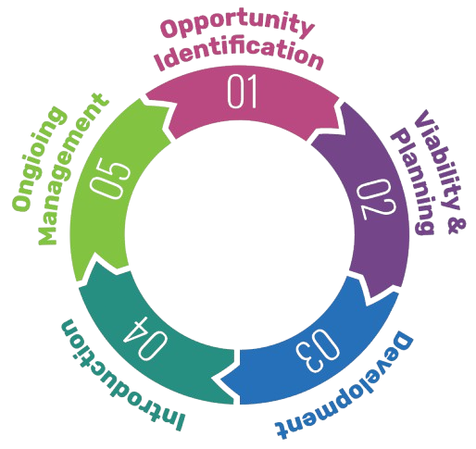
Let’s Recap!
1. Opportunity Identification - Recognized the increasing demand for a more efficient and scalable process to normalize real-world data (RWD).
2. Viability & Planning - Assessed the technical feasibility and potential business value, then developed a roadmap prioritizing the MVP, complete with timelines and key milestones.
3. Development - Worked with the engineering team through the complete development lifecycle, ensuring alignment with product goals.
4. Introduction - Launched the MVP to a targeted user group, gathered feedback, and iterated to deliver a refined V1 product.
5. Ongoing Management - Continuously track product performance, leveraging user feedback and market research to drive iterative improvements and identify opportunities for new features.

Slide 28
04
Outcomes
(Results)

Slide 29

Features
Data Normalization & Analysis: Scalable pipeline converts diverse clinical data into a unified model for streamlined analysis. Kicks off automatically, updates data upon data refreshes, robust anomaly detection.
QC Checks: Ensures data accuracy with validation checks throughout normalization.
Metadata Traceability: Integrated with DataHub for full lifecycle insights at each ETL stage.
User-Friendly Configurations: Non-technical users can manage settings & configs, reducing manual engineering effort.
CDM Library: Repository that contains all OMOP data models with API’s for users to access.
Cloud & OSS Integrations: Utilizes GCP for cloud debugging/storage/access and open-source tools for CDM quality assessment.

Slide 30

Outcomes
Post Launch…Success!
01
60% decrease in TAT for RWD Normalization. From 1 month -> 1 week.
➢ Product success was measured through KPI’s and pre-defined success metrics, highlighting all major metrics here.
02
40% less bugs reported by internal teams & external partners for data (based on completeness, accuracy, file formatting)
60%
03
12% increase in ML Model Risk Prediction accuracy.
40%
Faster RWD Normalization
Less bugs reported in Data
04
100% Adoption by RWD Analysts, no longer relying on manual methods.

Slide 31
05
Reflection
(Lessons)

Slide 32

So many lessons
Importance of Clear Communication
Regular updates and clear documentation helped prevent misunderstandings and kept everyone aligned.
Making sure to cater to your audience etc speaking non-technically with business and technically with engineering.
Ability to say No
There will oftentimes be competing requests for feature requests, and as a PM you need to know how to say no tactfully, using data backed points.
Flexibility in Product Development
Adapting to challenges, such as re-prioritizing features when necessary & sometimes doing work that’s out of scope but will help you achieve your product goal.
Being able to predict potential problems, identify issues & edge cases proactively.
Importance of team morale & stakeholder confidence.
Keeping the team motivated and stakeholders confident is key to product success.
Celebrate wins, foster collaboration, and maintain transparency to build trust and drive momentum.
Continuous learning & really understanding your product
Initially unfamiliar with biotech and real-world data (RWD)
Ramped up my understanding by engaging with subject matter experts, asking targeted questions, conducting research, and participating in hands-on exercises.

Slide 33

Thank You!
Notes:
That wraps up my presentation. Thank you all for your time and attention today.
I’m happy to take any questions you may have either about this project or my experience!

Slide 34
Reference QA Slides

Slide 35
How Does the Pipeline Work?
Pipeline Data Flow:
Data Ingestion: The process begins with reading data in-memory from a GCP bucket, which serves as the initial entry point of the pipeline.
Syntactic Normalization: The pipeline checks for and resolves data formatting issues, ensuring consistency eg misplaced commas, mismatched types.
Semantic Normalization: It standardizes codeset terminology to align with industry standards.
Structural Normalization: The data’s format is transformed to a common data model, such as OMOP or FHIR, and then stored in BigQuery datasets.
Post-Processing: Additional values and metrics are derived based on a set of business rules and added to BigQuery alongside the main data.
Quality Checks: Throughout the process, checks ensure data integrity. If any issues arise, processing is paused until an engineer or informaticist applies necessary corrections.
Post Processing CDM QC: QC is run on processed data using open source software from CDM provider (OMOP).

Slide 36
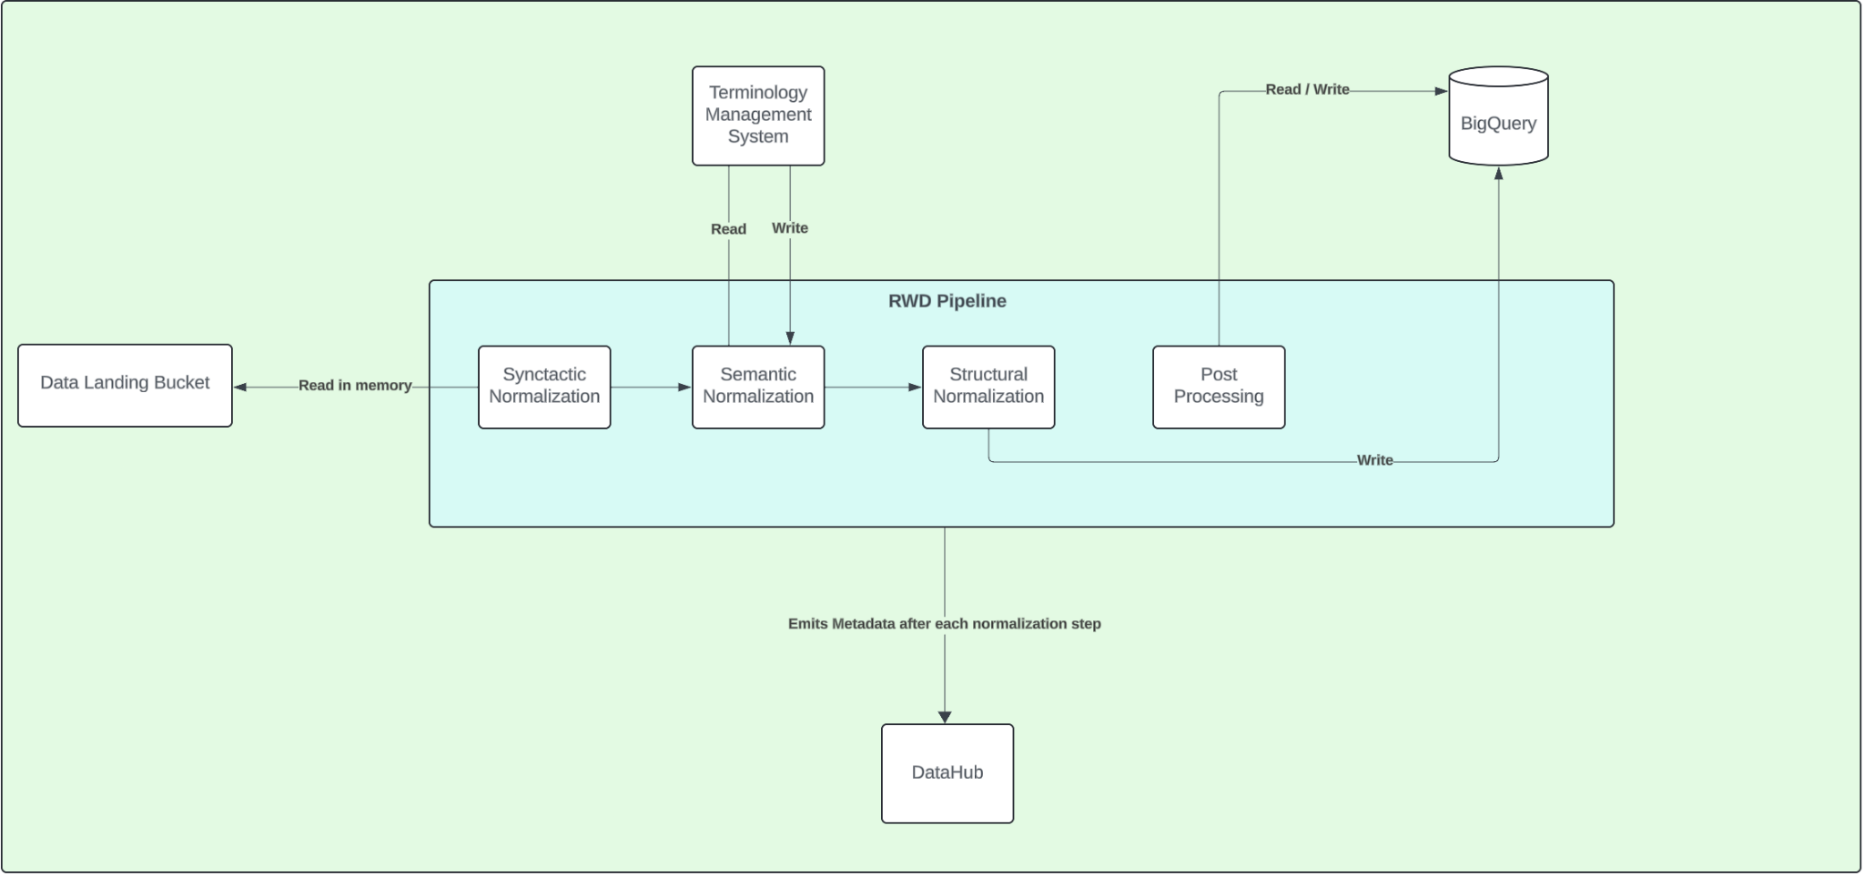
How Does the Pipeline Work?

Slide 37

What CDM are we using?
OMOP!
What It Is:
A standardized model to harmonize healthcare data from diverse sources.
Purpose:
Converts varied healthcare data (EHRs, claims, registries) into a uniform structure.
Facilitates data sharing, advanced analytics, and cross-study comparisons.
Key Features:
Standardized Tables: Organizes data into consistent tables (e.g., Person, Drug Exposure, Measurement).
Unified Vocabularies: Uses standard codes like SNOMED, LOINC, RxNorm for data mapping.
Scalability:
Adapts to different datasets, supporting broader research and AI/ML applications.
Benefits:
Enhances data quality, reduces ETL efforts, and fosters real-world evidence studies.

Slide 38




Technology Used
Python: Backend, Pandas, SQLGlot, Polars
Flyte: Task Orchestration Engine
Google Cloud Platform: Used Compute, BigQuery, Buckets, Pub/Sub, Looker
DataHub: Metadata Store
BigQuery: Data Lake for OMOP Data
JavaScript / React: Front end development

